Slide 1
Dasia Harmon
Experience in Agriculture
Supplemental Material: PowerPoint

Slide 2
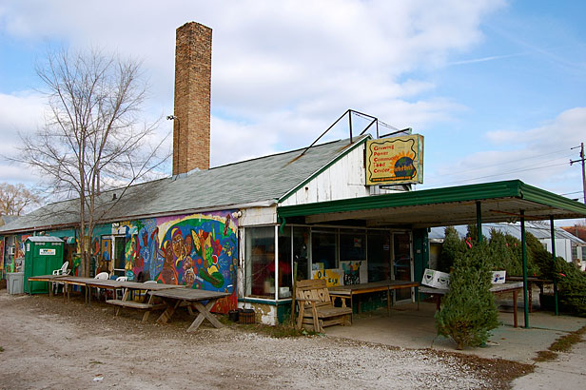
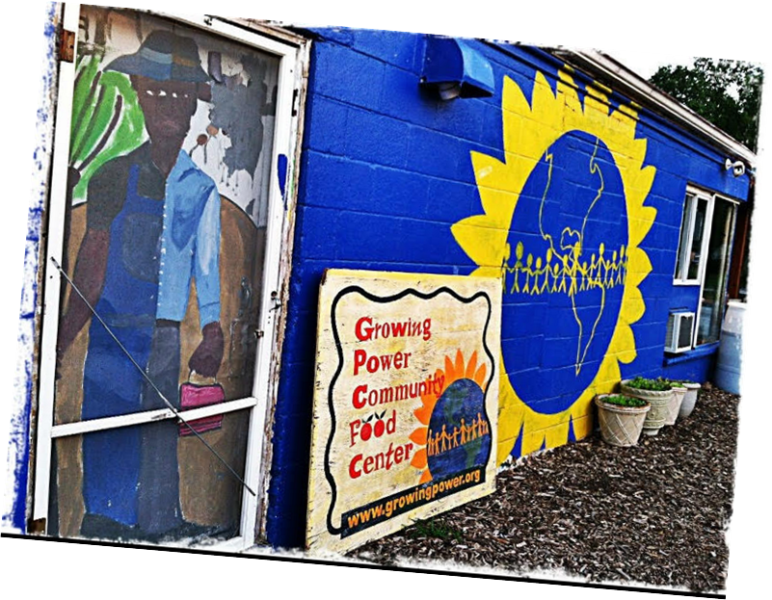
YOUTH CORE
At Growing Power in
Milwaukee, WI
2001-2009

Slide 3
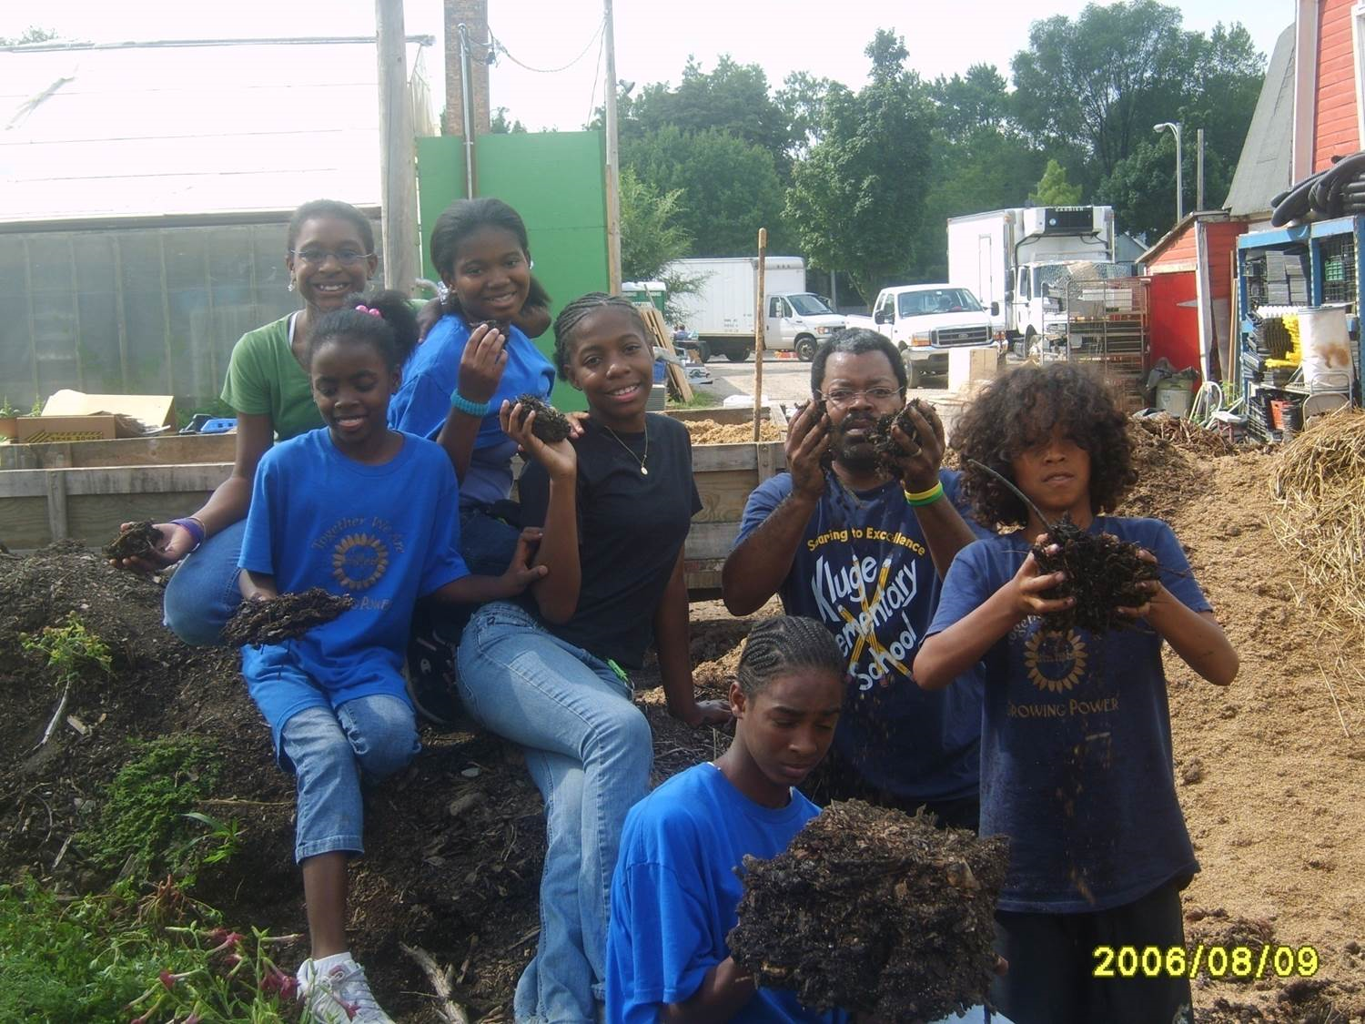
Growing Power, Inc

Slide 4
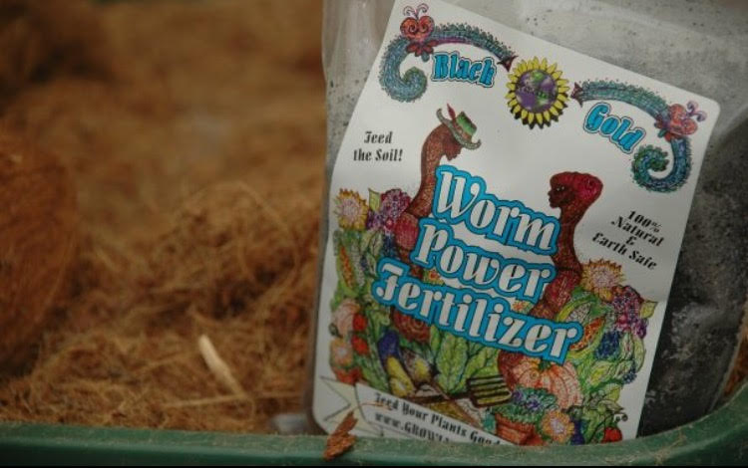

Slide 5
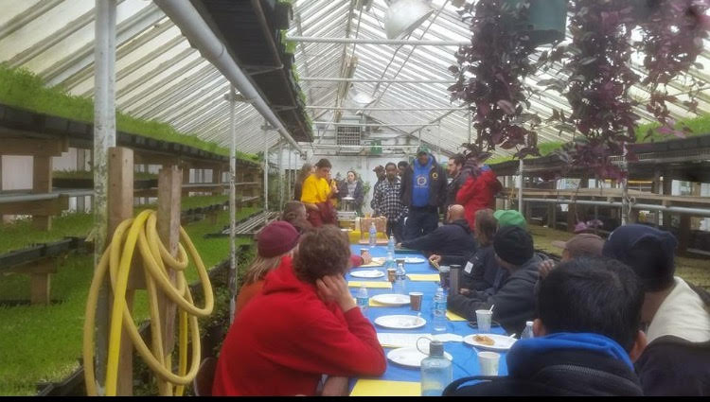
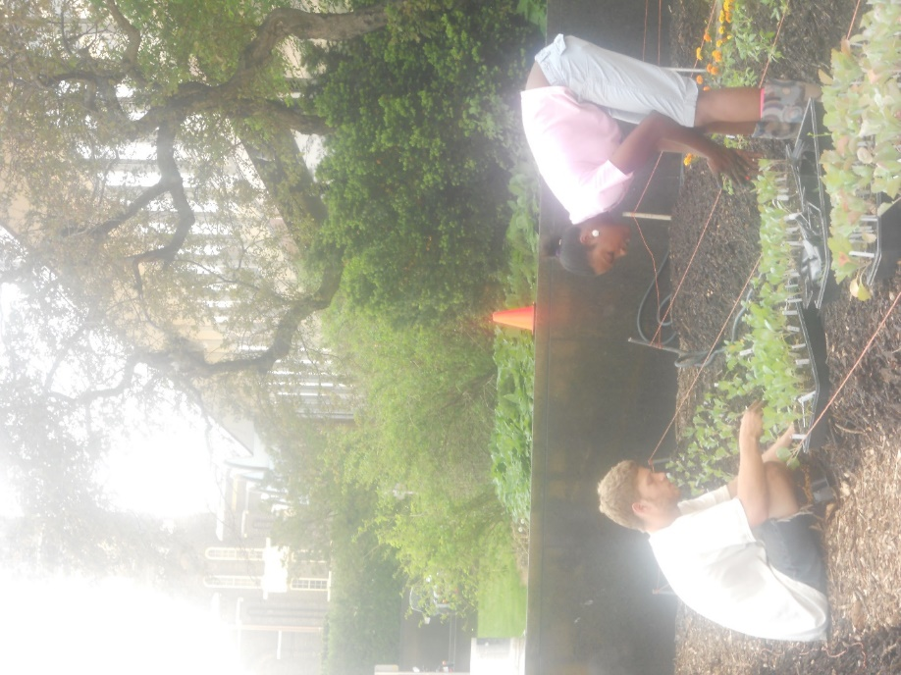

Slide 6
Will Allen, founder and CEO of Growing Power Inc. farmer, my mentor!

Slide 7
Fort Valley State University
College of Agriculture
2009-2014

Slide 8
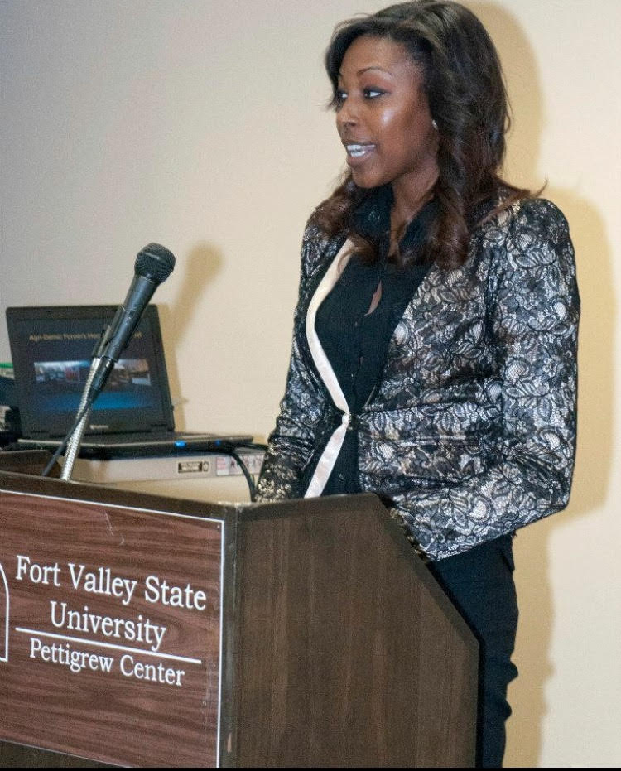
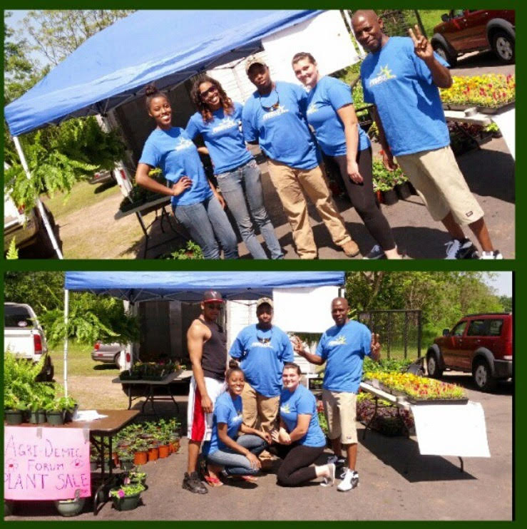
President of Agridemic Forum 2013, 2014
Before
After

Slide 10
GRADUATE SCHOOL at
Florida A&M University in
Tallahassee, FL
2014-2016

Slide 11
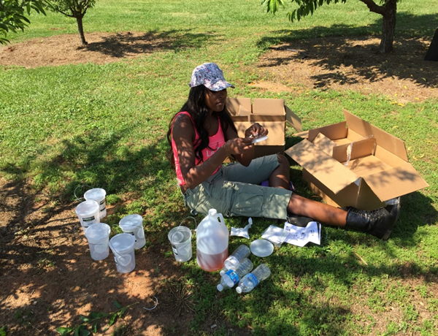
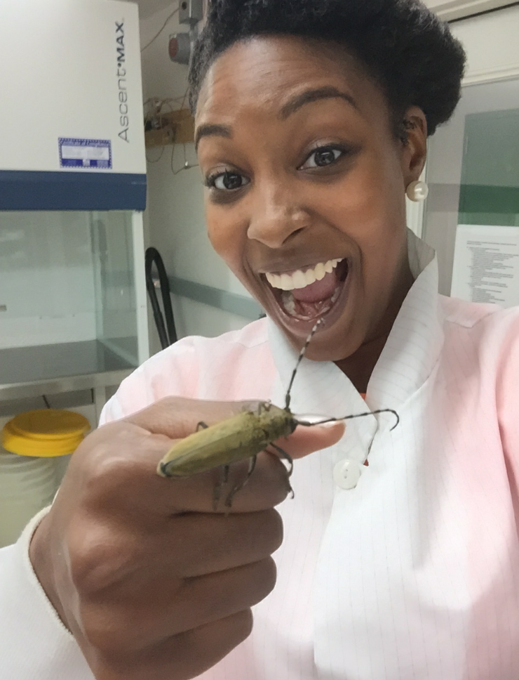
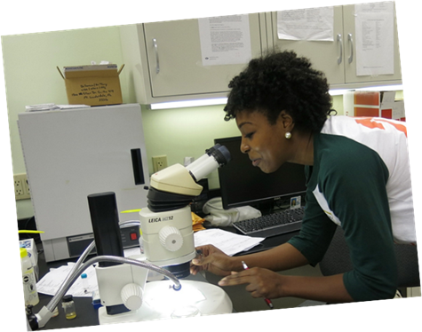
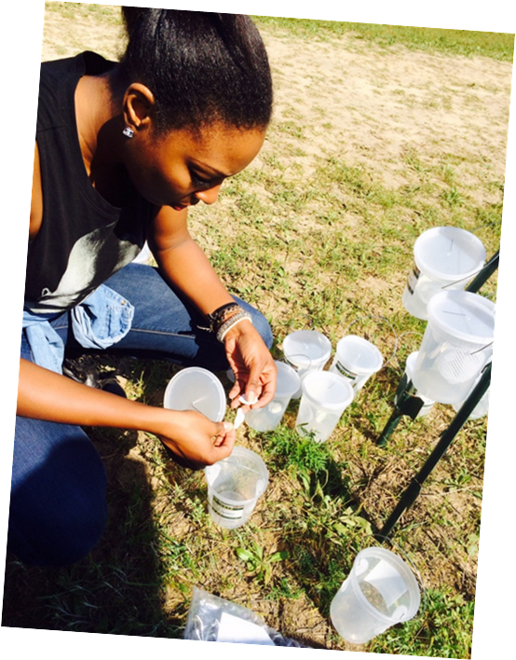
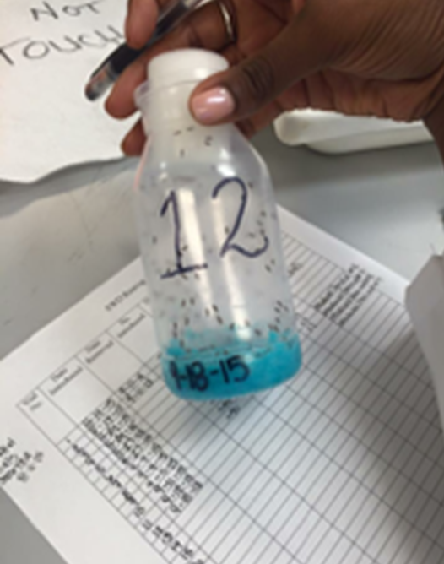
Entomology!!!
Entomology!!!

Slide 12
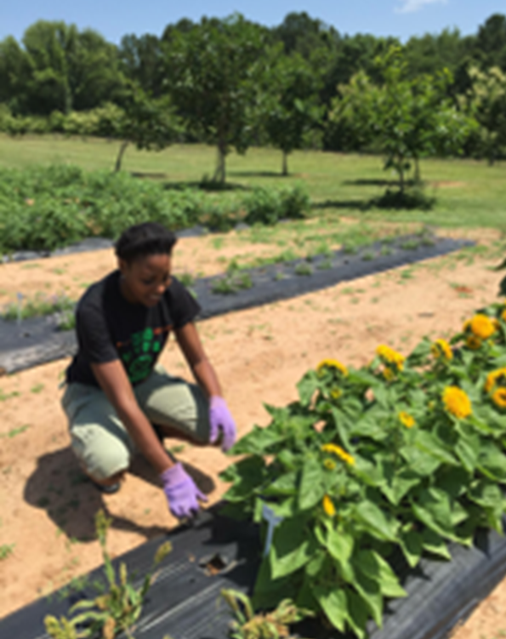
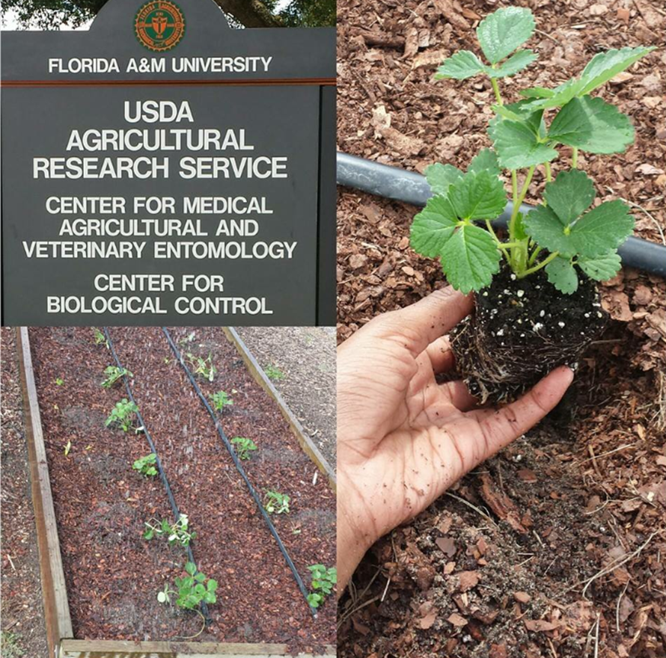

Slide 13
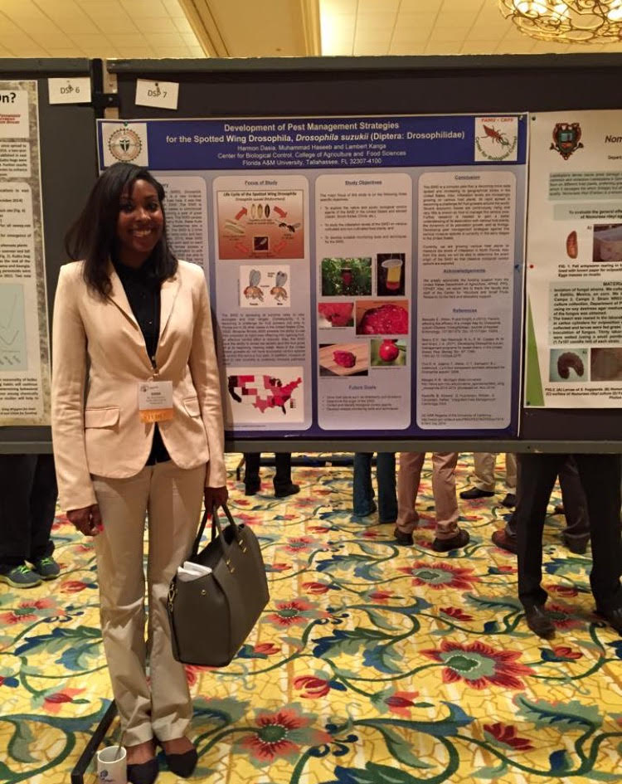
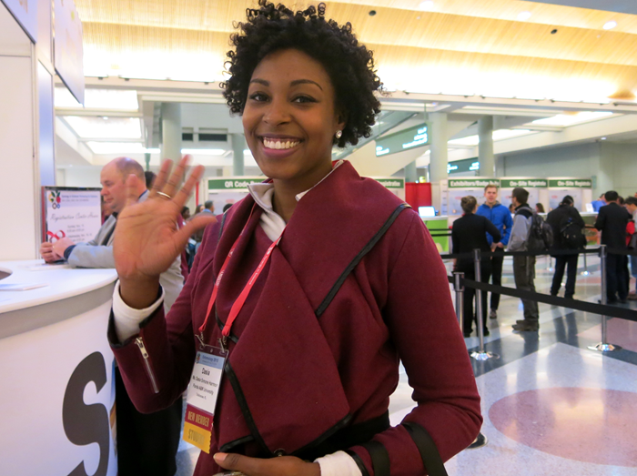
Raleigh, NC
South Eastern Branch Entomological Society of America 2016
Biloxi, MS
South Eastern Branch Entomological Society of America 2015

Slide 14
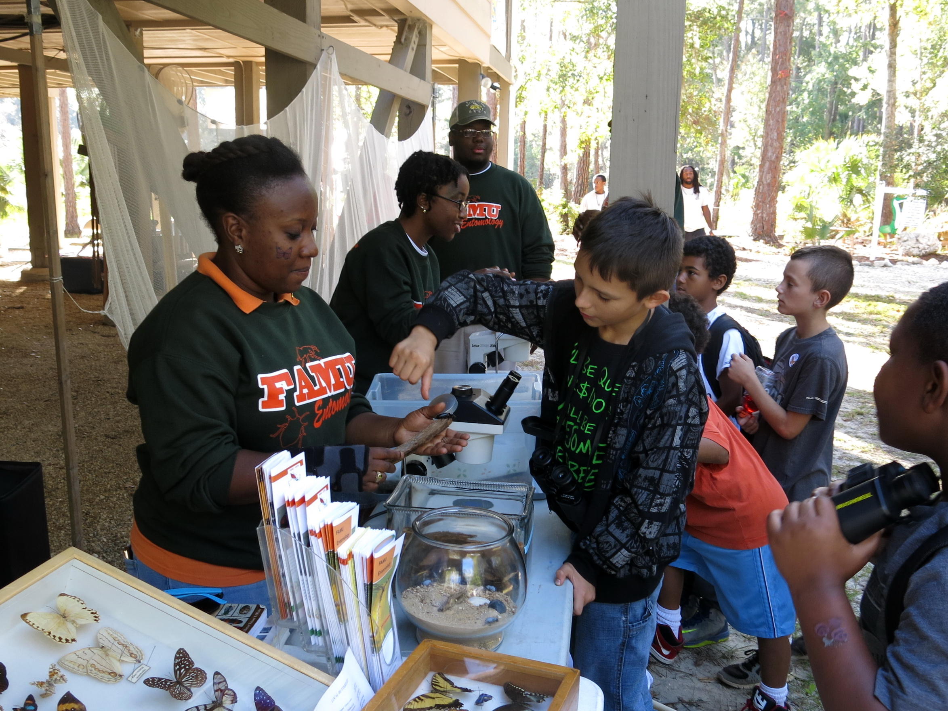
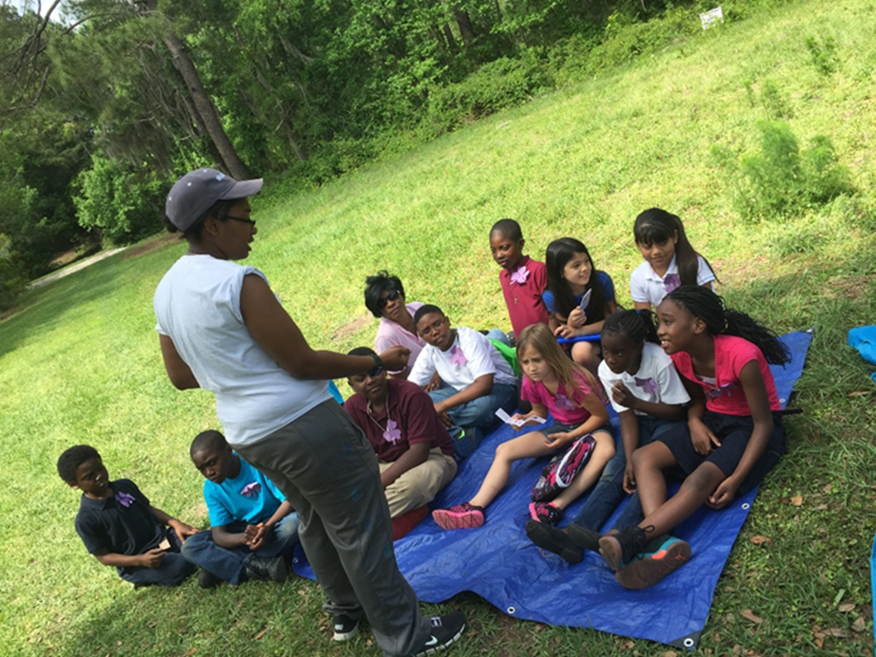
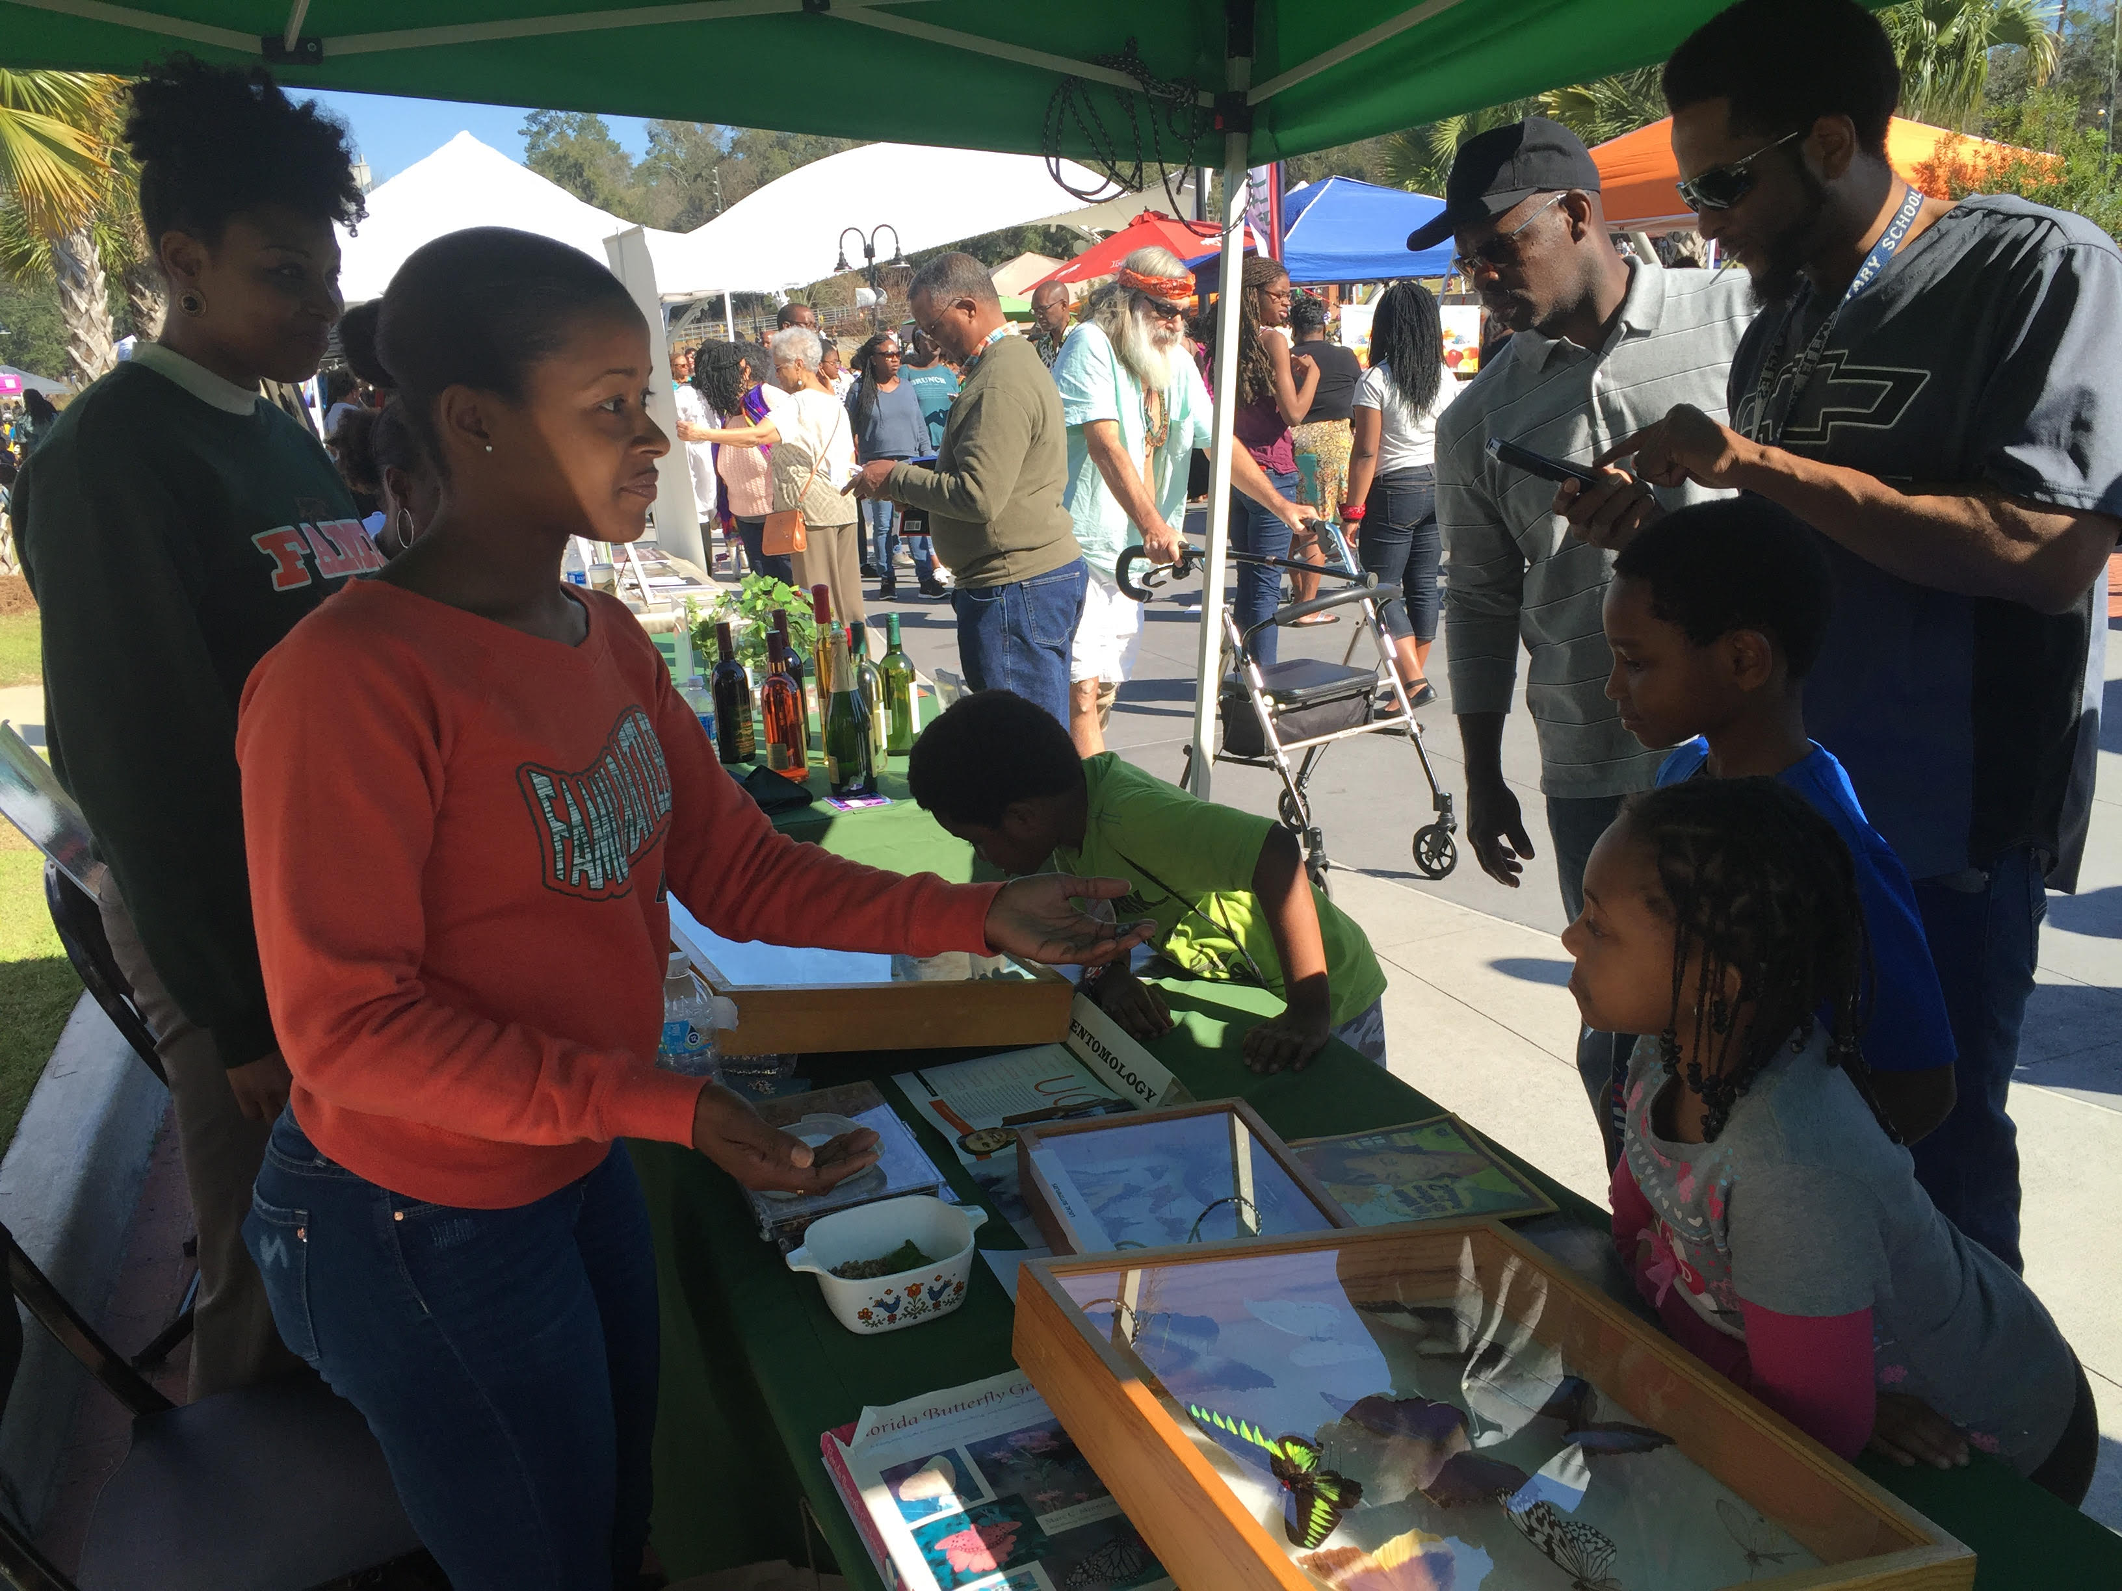
Science Fair Tallahassee, FL 2015
Harambee Festival Tallahassee, FL 2016

Slide 15
WHY ?!
Thank You For Watching!!!
Punctual
Experienced
Enthusiastic
Well Rounded
Patient

